Slide 1
Arrays in C
Anand Magar

Slide 2
Arrays are used to store multiple values in a single variable, instead of declaring separate variables for each value
e.g.
int myNumbers[] = {25, 50, 75, 100};

Slide 3
Access the Elements of an Array
To access an array element, refer to its index number.
Array indexes start with 0: [0] is the first element. [1] is the second element, etc.
This statement accesses the value of the first element [0] in myNumbers:

Slide 4
Access the Elements of an Array
Example
int myNumbers[] = {25, 50, 75, 100}; printf("%d", myNumbers[0]); // Outputs 25

Slide 5
Loop Through an Array
You can loop through the array elements with the for loop.
The following example outputs all elements in the myNumbers array:
int myNumbers[] = {25, 50, 75, 100}; int i; for (i = 0; i < 4; i++) { printf("%d\n", myNumbers[i]); }

Slide 6
Set Array Size
// Declare an array of four integers: int myNumbers[4]; // Add elements myNumbers[0] = 25; myNumbers[1] = 50; myNumbers[2] = 75; myNumbers[3] = 100;

Slide 7
Multidimensional Arrays
if you want to store data as a tabular form, like a table with rows and columns, you need to get familiar with multidimensional arrays
A multidimensional array is basically an array of arrays
Arrays can have any number of dimensions

Slide 8
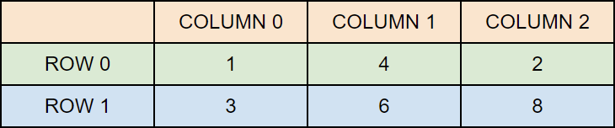
Two-Dimensional Arrays
A 2D array is also known as a matrix (a table of rows and columns).
To create a 2D array of integers
int matrix[2][3] = { {1, 4, 2}, {3, 6, 8} };

Slide 9
Access the Elements of a 2D Array
To access an element of a two-dimensional array, you must specify the index number of both the row and column.
This statement accesses the value of the element in the first row (0) and third column (2) of the matrix array/
int matrix[2][3] = { {1, 4, 2}, {3, 6, 8} }; printf("%d", matrix[0][2]); // Outputs 2

Slide 10
Loop Through a 2D Array
int matrix[2][3] = { {1, 4, 2}, {3, 6, 8} }; int i, j; for (i = 0; i < 2; i++) { for (j = 0; j < 3; j++) { printf("%d\n", matrix[i][j]); } }

Slide 11
Functions in C
Anand Magar

Slide 12
Fuctions
A function is a block of code which only runs when it is called.
You can pass data, known as parameters, into a function.

Slide 13
Predefined Functions
int main() { printf("Hello World!"); return 0; }
printf() is a function; used to output/print text to the screen

Slide 14
Create a Function
To create (often referred to as declare) your own function, specify the name of the function, followed by parentheses () and curly brackets {}
void myFunction() { // code to be executed }
myFunction() is the name of the function
void means that the function does not have a return value.
Inside the function (the body), add code that defines what the function should do

Slide 15
Call a Function
// Create a function void myFunction() { printf("I just got executed!"); } int main() { myFunction(); // call the function return 0; } // Outputs "I just got executed!"

Slide 16
A function can be called multiple times
void myFunction() { printf("I just got executed!"); } int main() { myFunction(); myFunction(); myFunction(); return 0; }

Slide 17
Parameters and Arguments
Information can be passed to functions as a parameter. Parameters act as variables inside the function.
Syntax
returnType functionName(parameter1, parameter2, parameter3) { // code to be executed }

Slide 18
e.g.
void myFunction(char name[]) { printf("Hello %s\n", name); } int main() { myFunction("Liam"); myFunction("Jenny"); myFunction("Anja"); return 0; } // Hello Liam // Hello Jenny // Hello Anja

Slide 19
When a parameter is passed to the function, it is called an argument.
name is a parameter, while Liam, Jenny and Anja are arguments

Slide 20
Pass Arrays as Function Parameters
void myFunction(int myNumbers[5]) { for (int i = 0; i < 5; i++) { printf("%d\n", myNumbers[i]); } } int main() { int myNumbers[5] = {10, 20, 30, 40, 50}; myFunction(myNumbers); return 0; }

Slide 21
Return Values
int myFunction(int x) { return 5 + x; } int main() { printf("Result is: %d", myFunction(3)); return 0; } // Outputs 8 (5 + 3)

Slide 22
Function Declaration and Definition
A function consist of two parts:
Declaration: the function's name, return type, and parameters (if any)
Definition: the body of the function (code to be executed)

Slide 23
// Function declaration void myFunction(); // The main method int main() { myFunction(); // call the function return 0; } // Function definition void myFunction() { printf("I just got executed!"); }

Slide 24
e.g.
// Function declaration int myFunction(int, int); // The main method int main() { int result = myFunction(5, 3); // call the function printf("Result is = %d", result); return 0; } // Function definition int myFunction(int x, int y) { return x + y; }

Slide 25
Call By Value/ Call By Reference
Anand Magar

Slide 26
Def
Functions can be invoked in two ways: Call by Value or Call by Reference. These two ways are generally differentiated by the type of values passed to them as parameters.
Pass by value
Pass by Reference

Slide 27
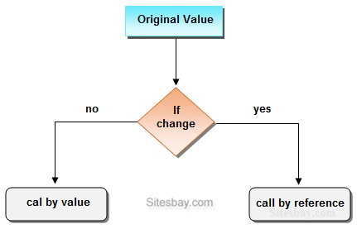

Slide 28
Call By Value
#include
void swap(int , int); //prototype of the function
int main()
{
int a = 10;
int b = 20;
printf("Before swapping the values in main a = %d, b = %d\n",a,b);
swap(a,b);
printf("After swapping values in main a = %d, b = %d\n",a,b);
}

Slide 29
Pass By Reference
#include
void swap(int *, int *); //prototype of the function
int main()
{
int a = 10;
int b = 20;
printf("Before swapping the values in main a = %d, b = %d\n",a,b);
swap(&a,&b);
printf("After swapping values in main a = %d, b = %d\n",a,b);
}

Slide 30
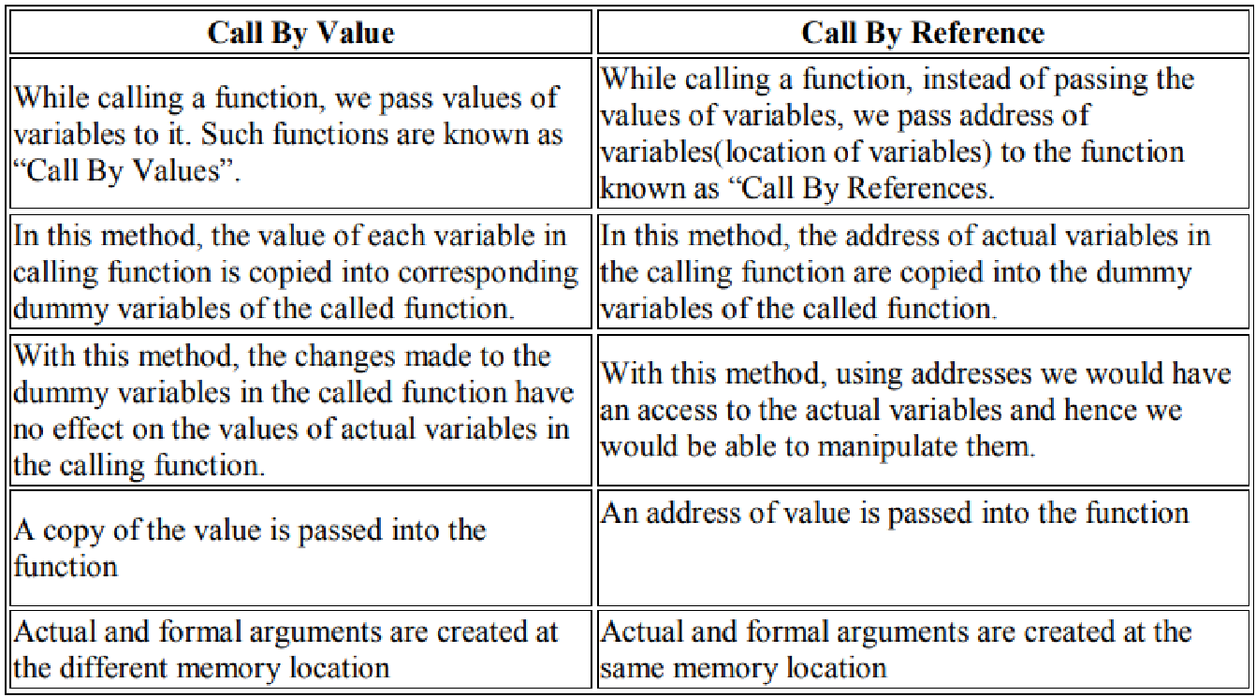

Slide 31
Recursion
Recursion is the technique of making a function call itself.
This technique provides a way to break complicated problems down into simple problems which are easier to solve.

Slide 32
Example
int sum(int k); int main() { int result = sum(10); printf("%d", result); return 0; } int sum(int k) { if (k > 0) { return k + sum(k - 1); } else { return 0; } }

Slide 33
Structures in C
Anand Magar

Slide 34
Structures
Structures (also called structs) are a way to group several related variables into one place. Each variable in the structure is known as a member of the structure.
Unlike an array, a structure can contain many different data types (int, float, char, etc.).

Slide 35
You can create a structure by using the struct keyword and declare each of its members inside curly braces
struct MyStructure { // Structure declaration int myNum; // Member (int variable) char myLetter; // Member (char variable) }; // End the structure with a semicolon

Slide 36
Create a struct variable with the name "s1"
struct myStructure { int myNum; char myLetter; }; int main() { struct myStructure s1; return 0; }

Slide 37
Access Structure Members
// Create a structure called myStructure struct myStructure { int myNum; char myLetter; }; int main() { // Create a structure variable of myStructure called s1 struct myStructure s1; // Assign values to members of s1 s1.myNum = 13; s1.myLetter = 'B'; // Print values printf("My number: %d\n", s1.myNum); printf("My letter: %c\n", s1.myLetter); return 0; }

Slide 38
What About Strings in Structures?
struct myStructure { int myNum; char myLetter; char myString[30]; // String }; int main() { struct myStructure s1; // Trying to assign a value to the string s1.myString = "Some text"; // Trying to print the value printf("My string: %s", s1.myString); return 0; }
An error will occur:

Slide 39
Use the strcpy() function and assign the value to s1.myString
struct myStructure { int myNum; char myLetter; char myString[30]; // String }; int main() { struct myStructure s1; // Assign a value to the string using the strcpy function strcpy(s1.myString, "Some text"); // Print the value printf("My string: %s", s1.myString); return 0; }

Slide 40
Pointers in C
Anand Magar

Slide 41
Defination
A pointer is a variable that stores the memory address of another variable as its value.
A pointer variable points to a data type (like int) of the same type, and is created with the * operator.

Slide 42
Assigning data to the pointer variable
syntax :
pointervariablename=&variablename;
For Example :
int *p, q=20;
p=&q;
Variable Value Address
q 500
P 5048
20
500

Slide 43
Example
int myAge = 43; // An int variable int* ptr = &myAge; // A pointer variable, with the name ptr, that stores the address of myAge // Output the value of myAge (43) printf("%d\n", myAge); // Output the memory address of myAge (0x7ffe5367e044) printf("%p\n", &myAge); // Output the memory address of myAge with the pointer (0x7ffe5367e044) printf("%p\n", ptr);

Slide 44
Create a pointer variable with the name ptr, that points to an int variable (myAge). Note that the type of the pointer has to match the type of the variable you're working with (int in our example).
Use the & operator to store the memory address of the myAge variable, and assign it to the pointer.
Now, ptr holds the value of myAge's memory address.

Slide 45
How to output address and value
int myAge = 43; // Variable declaration int* ptr = &myAge; // Pointer declaration // Reference: Output the memory address of myAge with the pointer (0x7ffe5367e044) printf("%p\n", ptr); // Dereference: Output the value of myAge with the pointer (43) printf("%d\n", *ptr);

Slide 46
Pointers to array
Example using array
int myNumbers[4] = {25, 50, 75, 100}; int i; for (i = 0; i < 4; i++) { printf("%d\n", myNumbers[i]); }

Slide 47
Relation between Array and Pointer
int myNumbers[4] = {25, 50, 75, 100}; // Get the memory address of the myNumbers array printf("%p\n", myNumbers); // Get the memory address of the first array element printf("%p\n", &myNumbers[0]);

Slide 48
Print First Element
int myNumbers[4] = {25, 50, 75, 100}; // Get the value of the first element in myNumbers printf("%d", *myNumbers);

Slide 49
Print particular element from array
int myNumbers[4] = {25, 50, 75, 100}; // Get the value of the second element in myNumbers printf("%d\n", *(myNumbers + 1)); // Get the value of the third element in myNumbers printf("%d", *(myNumbers + 2)); // and so on..

Slide 50
Printing using loop
int myNumbers[4] = {25, 50, 75, 100}; int *ptr = myNumbers; int i; for (i = 0; i < 4; i++) { printf("%d\n", *(ptr + i)); }

Slide 51
Example
int myNumbers[4] = {25, 50, 75, 100}; // Change the value of the first element to 13 *myNumbers = 13; // Change the value of the second element to 17 *(myNumbers +1) = 17; // Get the value of the first element printf("%d\n", *myNumbers); // Get the value of the second element printf("%d\n", *(myNumbers + 1));

Slide 52
Array of pointers
#include <stdio.h>
const int MAX = 3;
int main () {
int var[] = {10, 100, 200};
int i, *ptr[MAX];
for ( i = 0; i < MAX; i++) {
ptr[i] = &var[i]; /* assign the address of integer. */
}
for ( i = 0; i < MAX; i++) {
printf("Value of var[%d] = %d\n", i, *ptr[i] );
}
return 0;
}

Slide 53
Pointers as Function Arguments
When pointers are passed to a function :
The address of the data item is passed and thus the function can freely access the contents of that address from within the function
In this way, function arguments permit data-items to be altered in the calling routine and the function.
When the arguments are pointers or arrays, a call by reference is made to the function as opposed to a call by value for the variable arguments.

Slide 54
Pointers and functions
Call by Value
Int main()
{
void add(int,int);
Int a,b;
printf(“\nEnter two numbers: “);
scanf(“%d%d”,&a,&b);
add(a,b);
return 0;
}
void add_ptr(int x,int y)
{
int c; c=x + y; //x=&a and y=&b
printf("\nAnswer without pointer is: %d",c);
}

Slide 55
Pointers and functions
Call by reference
Int main()
{
void add_ptr(int*,int*);
printf(“\nEnter two numbers: “);
scanf(“%d%d”,&a,&b);
add_ptr(&a,&b);
return 0;}
void add_ptr(int *x,int *y)
{
int c; c=*x + *y; //x=&a and y=&b
printf("\nAnswer with pointer is: %d",c);
}

Slide 56
Reference
https://www.w3schools.com/c/c_pointers.php

Slide 57
Data Structure in C
Anand Magar

Slide 58
What is Data?
Data is Fact or Information
“In computing, data is information that has been translated into a form that is efficient for movement or processing”

Slide 59
Data Object
A data object is a
region of storage that contains a value or group of values.
Each value can be accessed using its identifier or
a more complex expression that refers to the object

Slide 60
Data Structures
“A data structure is a specialized format for organizing and storing data.”
General data structure types include the array, the file, the record, the table, the tree, and so on.
Any data structure is designed to organize data to suit a specific purpose so that it can be accessed and worked with in appropriate ways.

Slide 61
Abstract Data Type
An abstract data type (ADT) is a mathematical model for data types where a data type is defined by its behavior (semantics) from the point of view of a user of the data.
Specifically in terms of possible values, possible operations on data of this type, and the behavior of these operations.
When a class is used as a type, it is an abstract type that refers to a hidden representation.
In this model an ADT is typically implemented as a class, and each instance of the ADT is usually a n object of that class. In ADT all the implementation details are hidden.

Slide 62
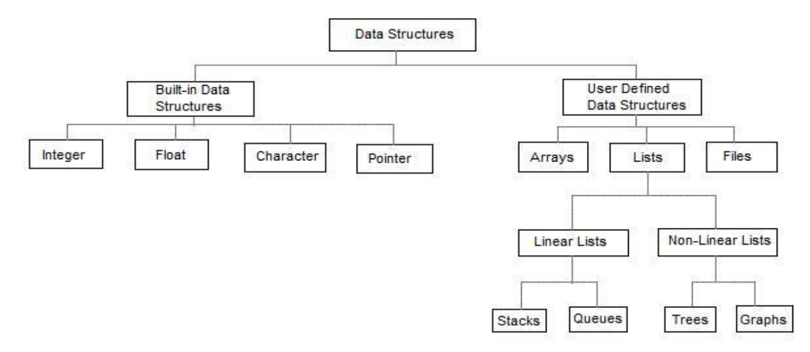
Data Structures

Slide 63
Linear Data Structure
Data structure where data elements are arranged sequentially or linearly where each and every element is attached to its previous and next adjacent is called a linear data structure
e.g.
array,
stack,
queue,
linked list

Slide 64
Non-Linear Data Structures
Data structures where data elements are not arranged sequentially or linearly are called non-linear data structures
examples
1. Trees
2. graphs

Slide 65
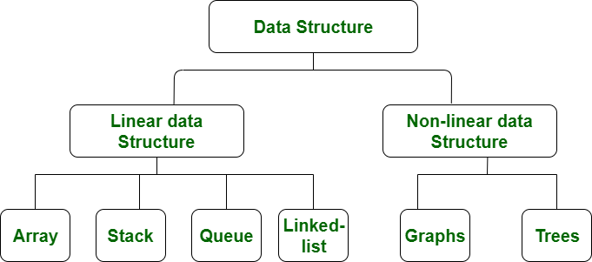
Linear Non-Linear Data Structures

Slide 66
S.NO | Linear Data Structure | Non-linear Data Structure
1. | In a linear data structure, data elements are arranged in a linear order where each and every element is attached to its previous and next adjacent. | In a non-linear data structure, data elements are attached in hierarchically manner.
2. | In linear data structure, single level is involved. | Whereas in non-linear data structure, multiple levels are involved.
3. | Its implementation is easy in comparison to non-linear data structure. | While its implementation is complex in comparison to linear data structure.
4. | In linear data structure, data elements can be traversed in a single run only. | While in non-linear data structure, data elements can’t be traversed in a single run only.
5. | In a linear data structure, memory is not utilized in an efficient way. | While in a non-linear data structure, memory is utilized in an efficient way.

Slide 67
Static and Dynamic Data Structures
In static data structures memory is allocated at the compiler time
Dynamic data structures are of dynamic size and memory is allocated at the runtime for them by the program.

Slide 68
Persistent and non-persistent data structures
In computing, a persistent data structure or not ephemeral data structure is a data structure that always preserves the previous version of itself when it is modified.
Ephemeral Data Structure is a Data Structure which is neither persistent nor partially persistent

